Slide 1



Bed bugs
Shaku Nair, Dawn Gouge, Shujuan Li
University of Arizona Maricopa Ag. Center
37860 W. Smith-Enke Road
Maricopa, AZ 85138

Slide 2
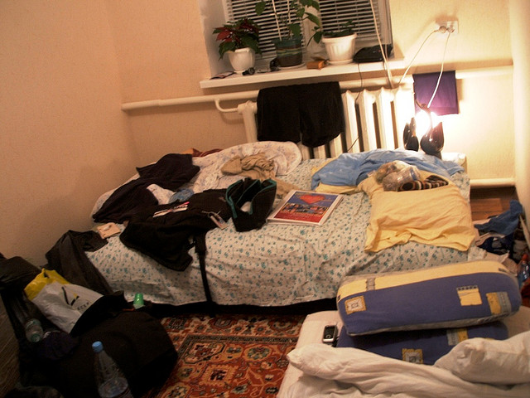
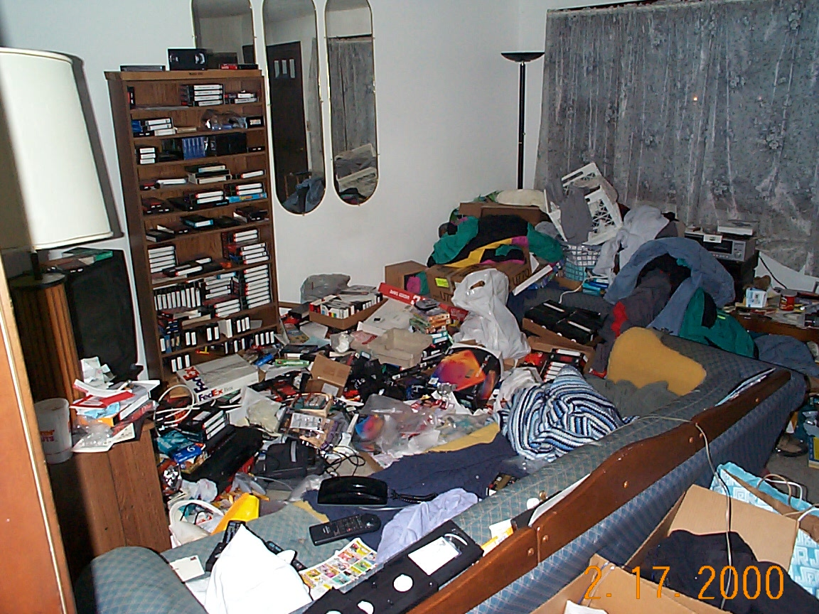

Slide 3
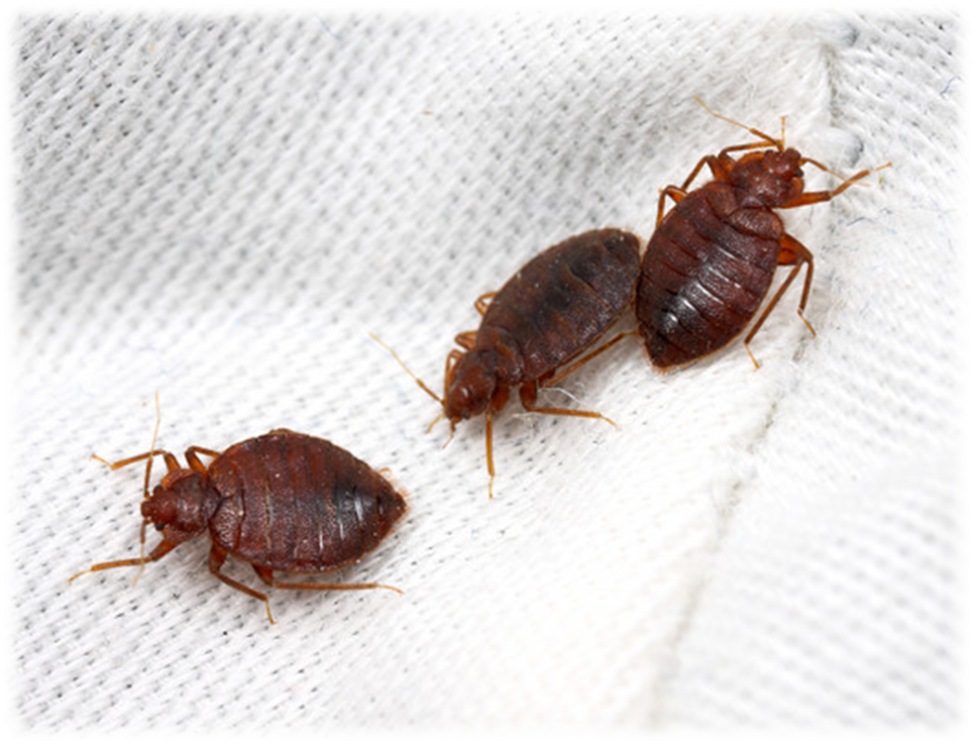
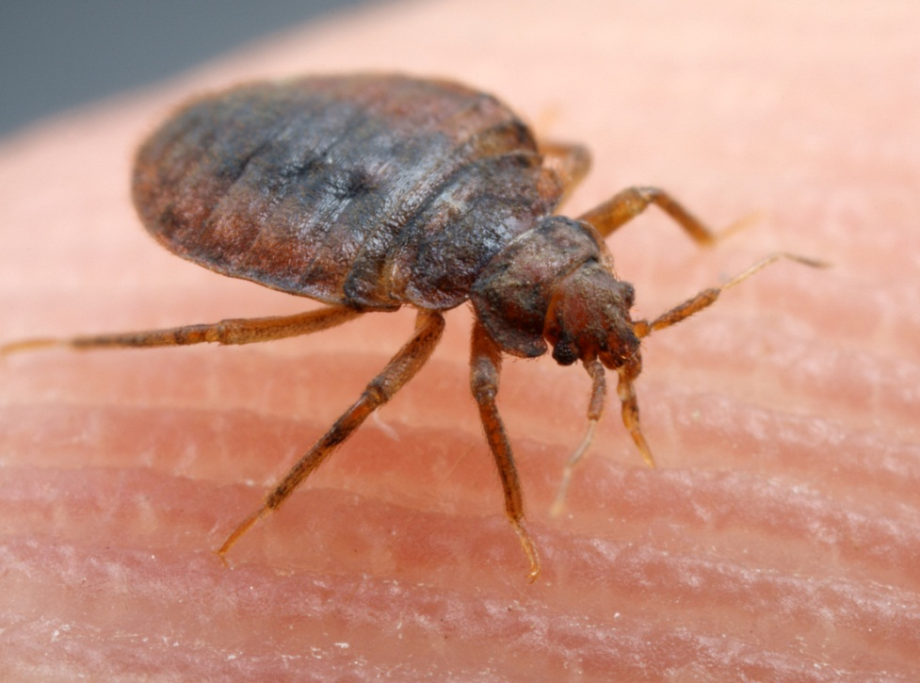
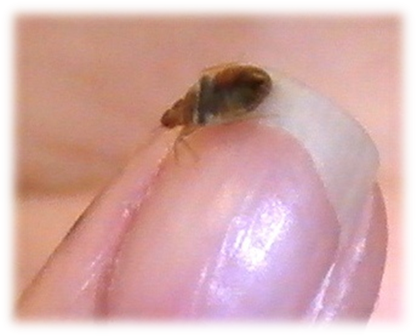
Anyone
can accidently
acquire bed
bugs

Slide 4
Where are the bed bugs?

Slide 5
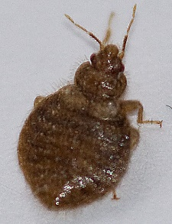
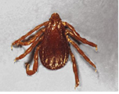
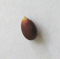
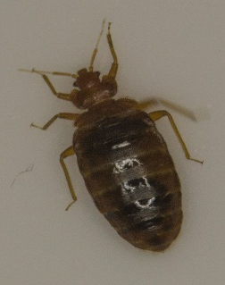
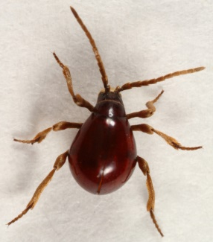
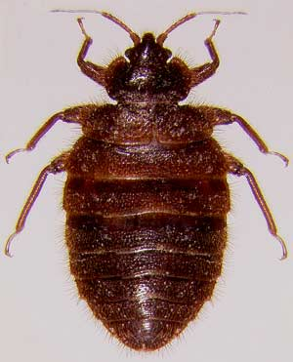
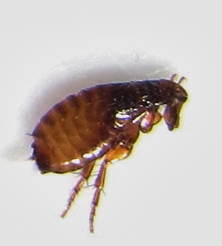
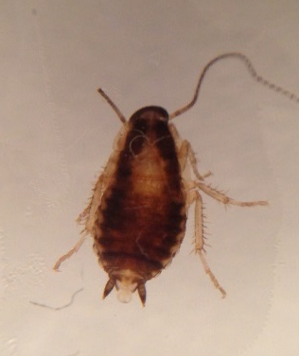
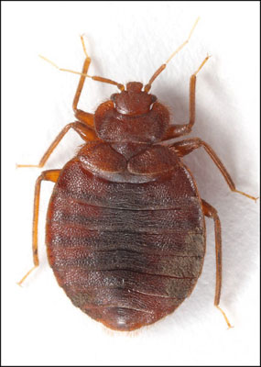
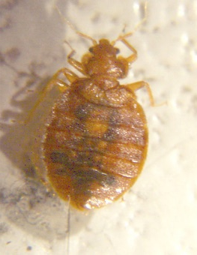
Find the bed bug
1
2
3
4
5
Swallow bug
Brown dog tick
✓
Apple seed
Shiny spider beetle
7
10
6
8
9
Bat bug
Cat flea
German cockroach
nymph
✓
Mexican poultry bug

Slide 6
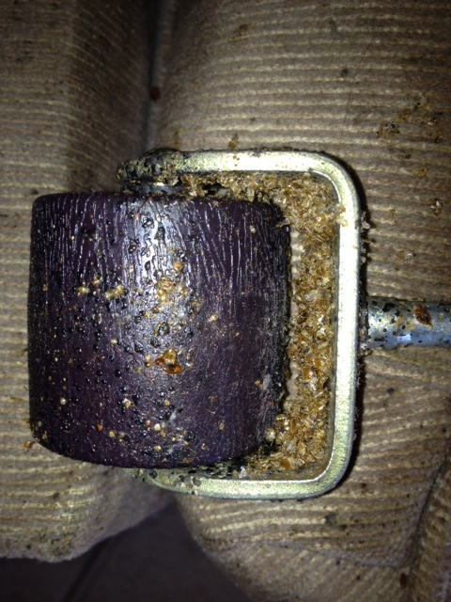
What are we going to cover?
What are bed bugs
History
Resurgence
Biology
Signs
School
Social impacts
Chemical disasters

Slide 7
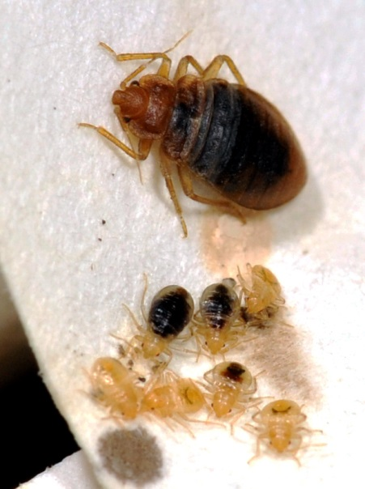
What are bed bugs?
True bugs
Order Hemiptera
Family Cimicidae
Cimex lectularius
Notes:
Bed bugs are blood-feeding insects in the order Hemiptera (also called true bugs) they go through incomplete metamorphosis (gradual) and the life stages are best described as?
Baby bed bug, young immature bed bug, adult bed bug
Egg, five immature nymph stages, and a final sexually mature adult stage
Larva, adult
Egg, larva, pupa, adult

Slide 8
Places most likely to have bed bug infestations
Homes and places where people sleep
Offices
Schools
0 of 0

Slide 9
Bed Bugs can disperse by……..
Flying and jumping on to new hosts
Crawling on to clothing, backpacks, shoes and personal items of hosts
Attaching to pet animals and dropping off when they sense a human host
0 of 27

Slide 10
Bed bugs harm us by…
Biting, feeding on our blood, disturbing sleep
Transmitting deadly blood-borne diseases
Staining beds, bedding, clothes and furniture
Causing adverse social and financial effects
Attacking and infesting our pets
0 of 27

Slide 11
The size of an adult bed bug is ……..
The size of a pin head at first, and the size of a pea after feeding
About the size of a sesame seed
About the size of an apple seed
0 of 28

Slide 12
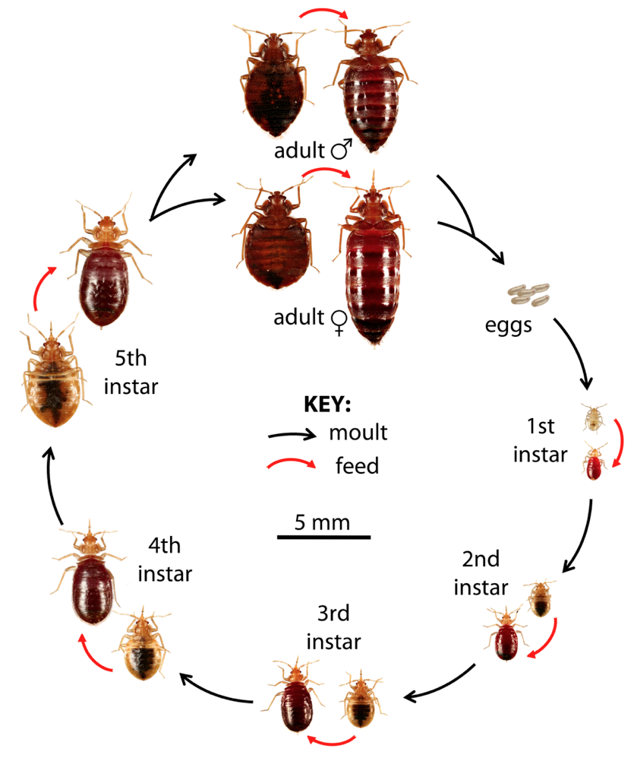
The Bed Bug Life Cycle
Egg
Nymph (5 stages)
Adults
Bed bugs need to feed on blood at least once during each life stage after hatching.

Slide 13
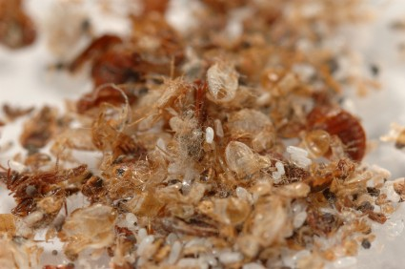
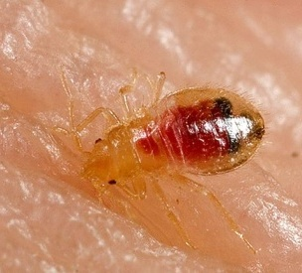
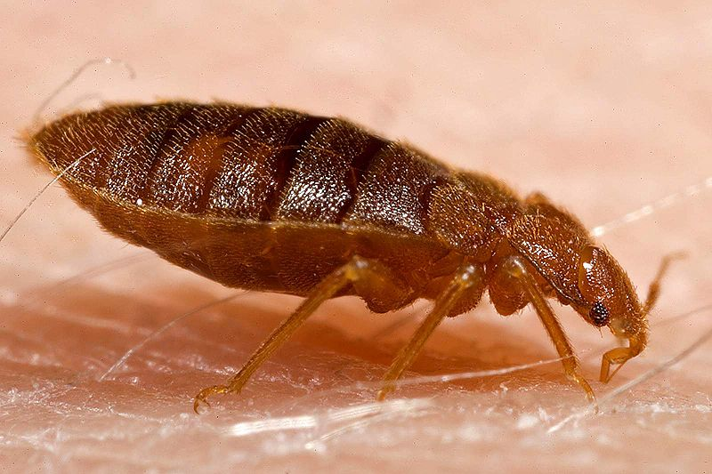
Adults are about the size of an apple seed

Slide 14
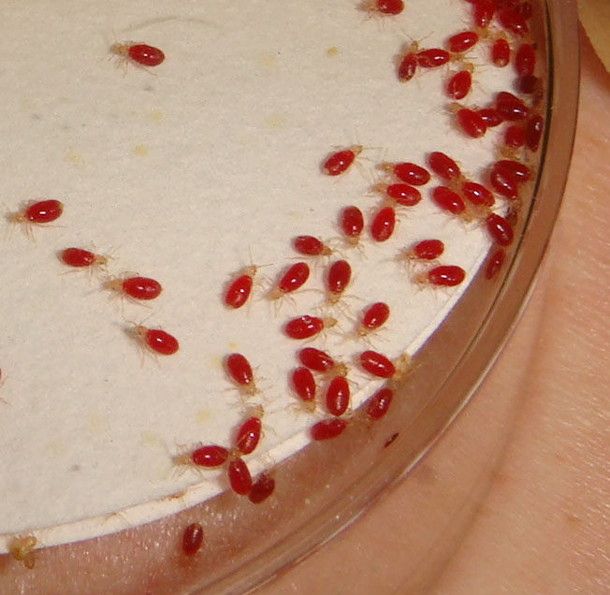
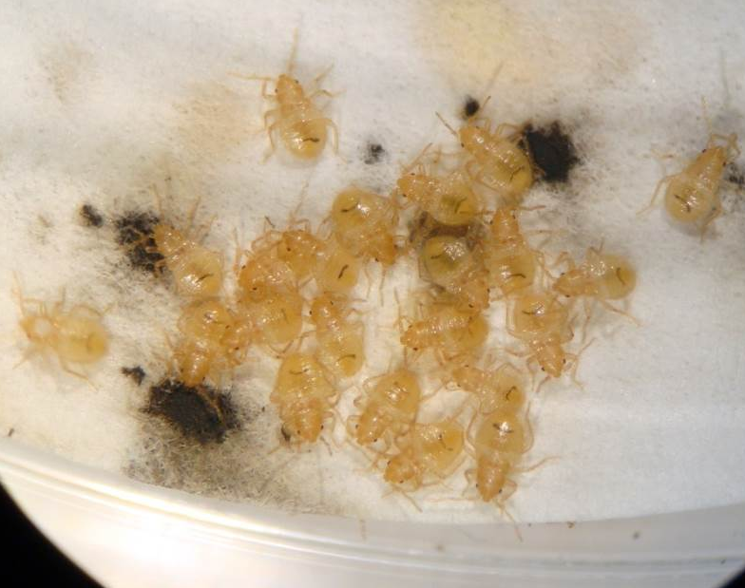
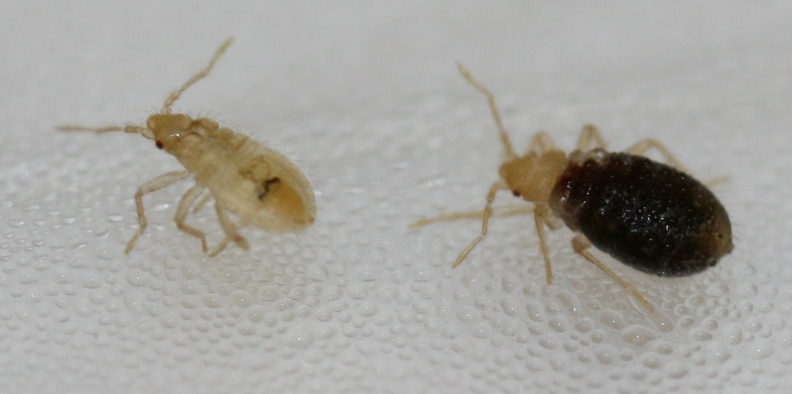
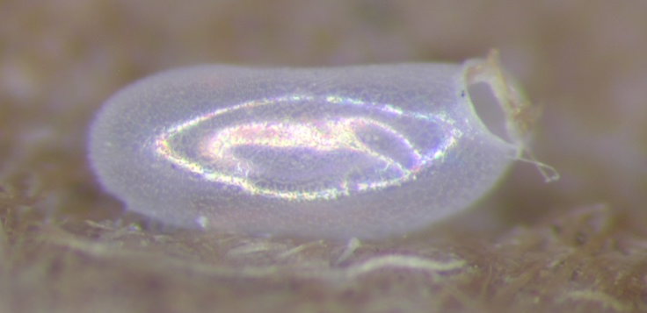

Slide 15
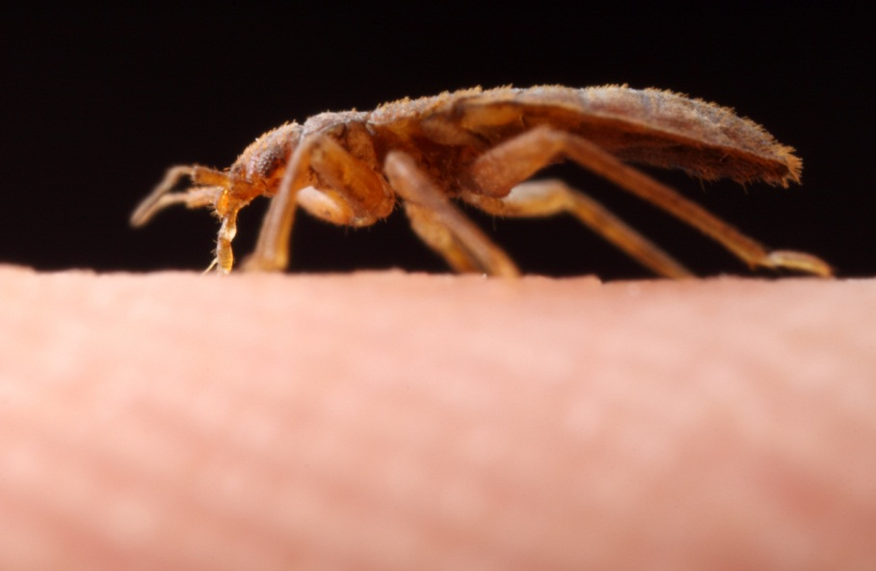

Slide 16
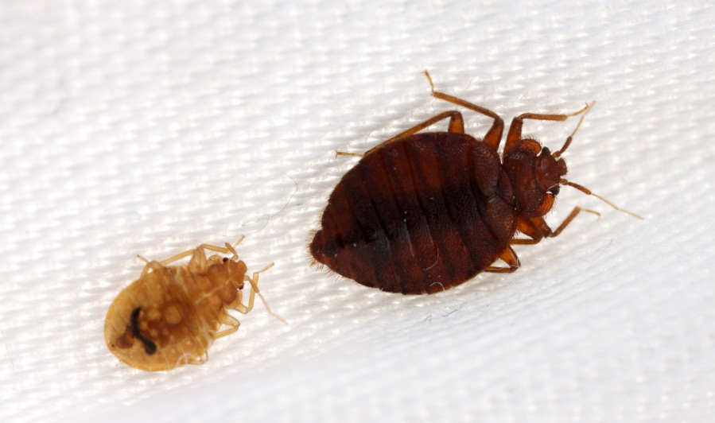
Bed bugs are not known to effectively transmit disease organisms

Slide 17
In a home, where do bed bugs hide? (Choose the top 3)
  a.) box springs
  b.) couches / chairs
  c.) mattresses
  d.) night stand / dresser
  e.) baseboards and moldings
  f.) head boards and bed frames
  g.) walls / ceilings
  h.) TV remotes
  i.) curtains / drapes
  j.) toilets

Slide 18
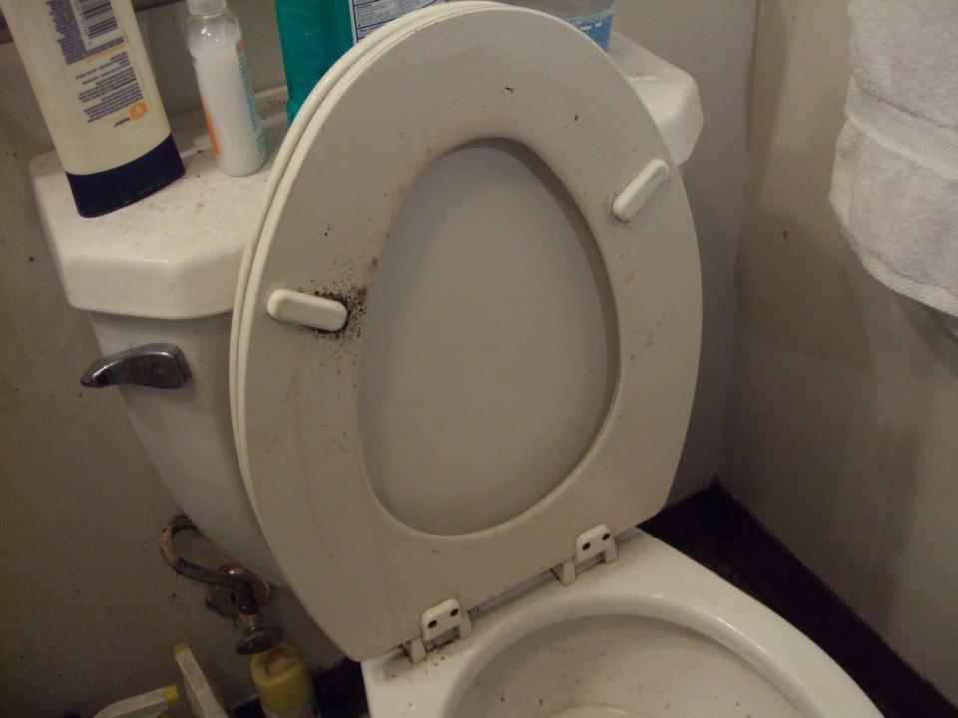
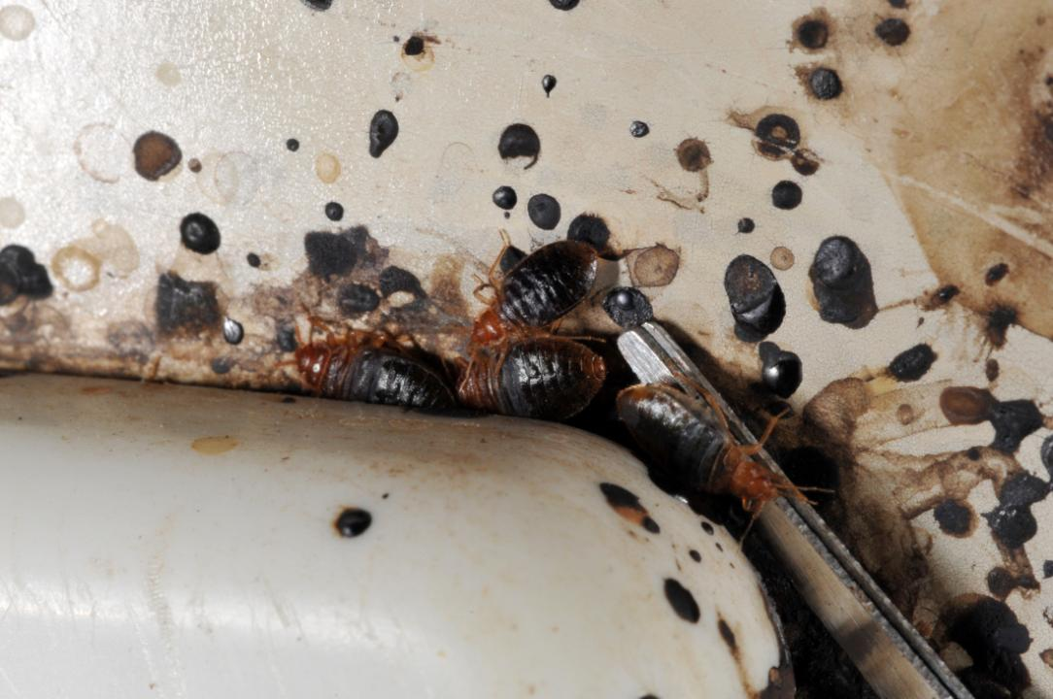
Toilets
Even in the loo!
Notes:
Television and other remote controls, in the battery compartment
Telephones, cell and cordless phones
Lamps and alarm clock
Computers and other electronics
Cardboard boxes in closets and under the bed
Children’s toys and stuffed animals
Jewelry boxes
Brick walls and “popcorn” or other textured ceilings
Books, magazines, newspapers and files
Inside hollow doors
Ceiling light fixtures, smoke detectors
Heating units, air conditioners and ducts
Wheelchairs
Toilet seats

Slide 19
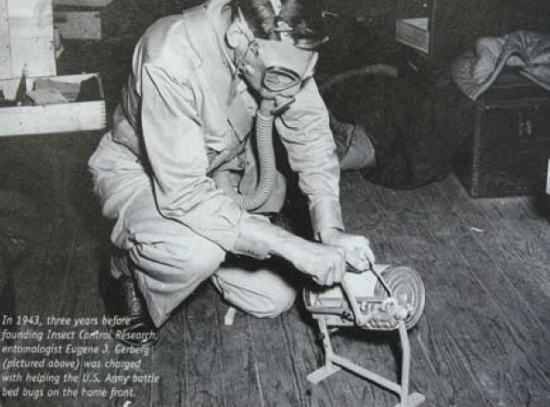
History
1910 -1940 bed bugs became a community-wide problem in US
Infestations were worse in poorer, overcrowded
communities,
although
wealthy
households
had problems
as well
Fumigation with hydrogen cyanide

Slide 20
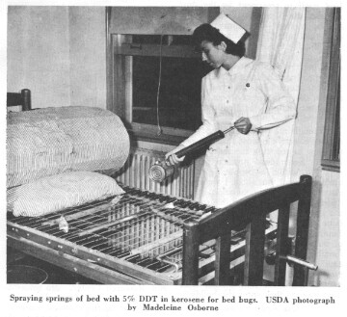
Common pest in the US at the turn of the century
Almost eradicated in 1940-50 due to DDT
Resistance
documented
to DDT,
malathion,
carbamates
and
pyrethroids

Slide 21
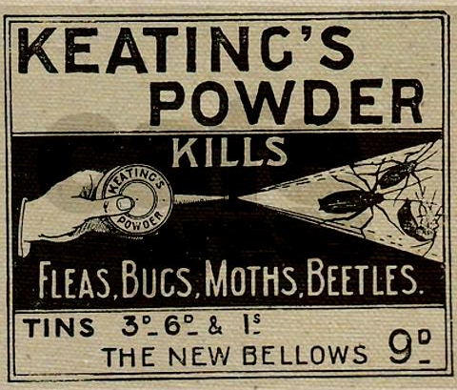
Pull beds away from walls
Place bed legs in pans of oil
Application of pyrethrum powder (dried chrysanthemum flowers) dusted between the sheets of a bed
Vigorous housecleaning, washing
bedding/beds
Dousing slats, springs,
and crevices with
boiling water or grease
from salt pork or bacon

Slide 22
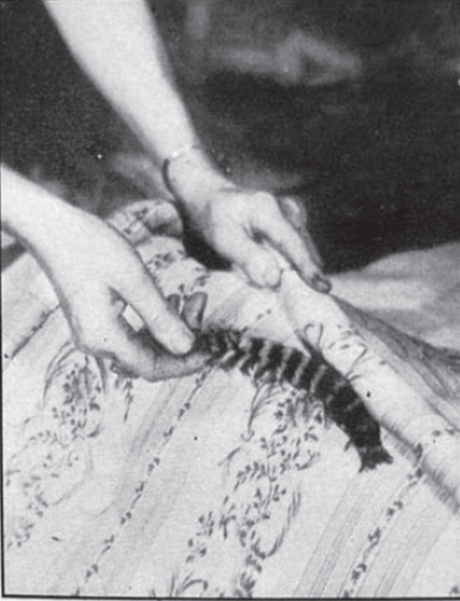
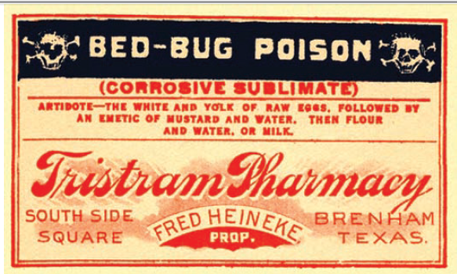
People resorted to extremely dangerous practices
Mercury chloride applied to the mattress using a feather
“Sometimes it is possible to destroy a light infestation by thorough soaking of the bed and other places with high-test gasoline”
Doner and Thomssen 1943

Slide 23
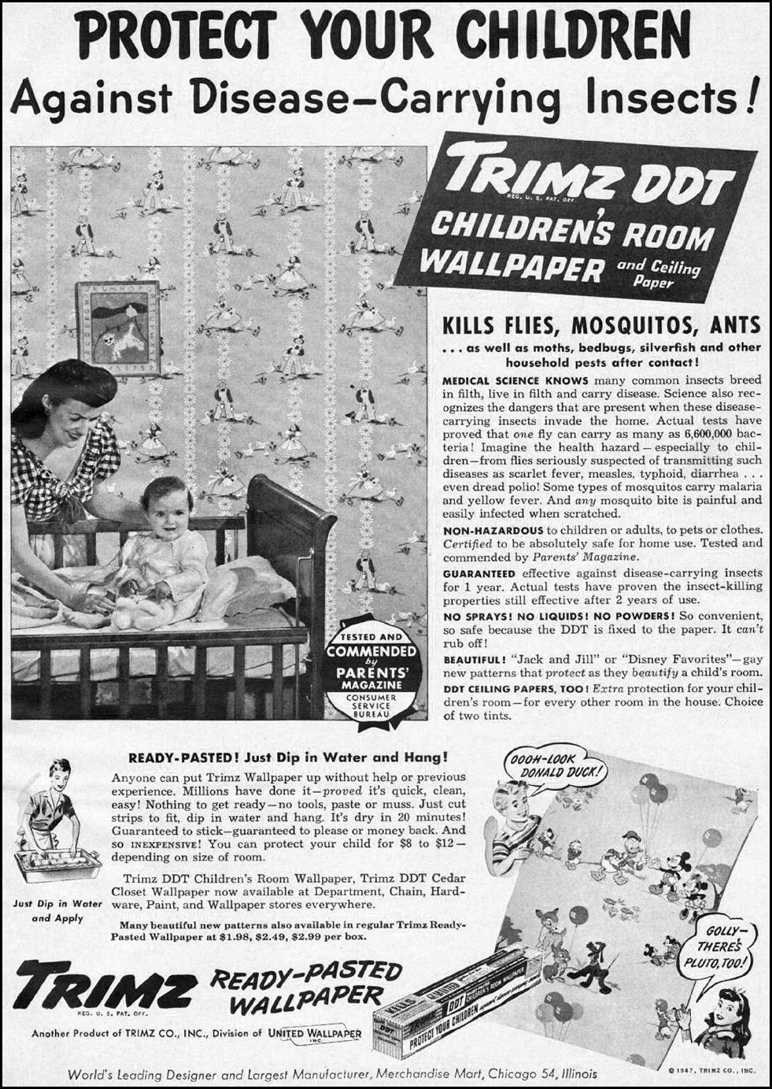
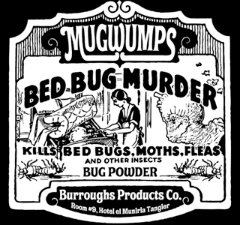
1947
There was little understanding of chemical exposure risks
DDT impregnated wall paper

Slide 24
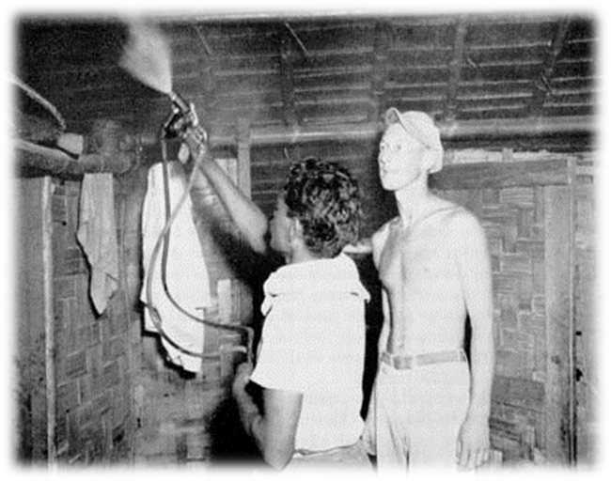
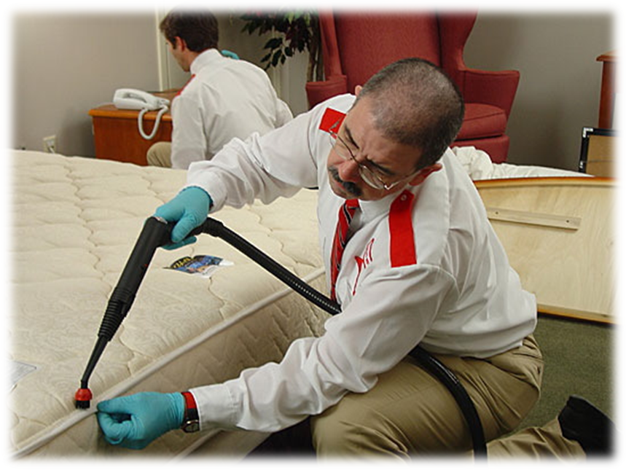
Management relied upon
Labor intensive
Detailed work
Constant monitoring
This is just as true today as it was then, despite technological advances

Slide 25
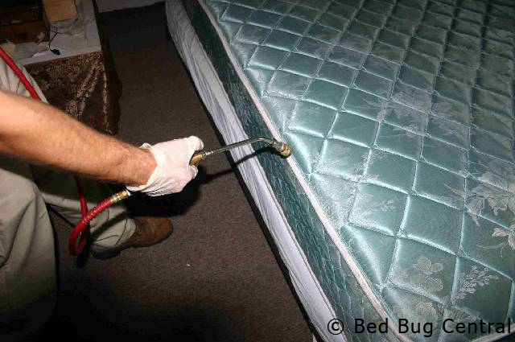
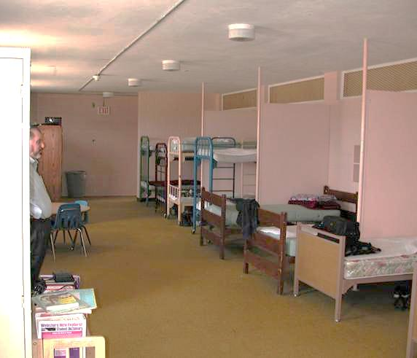
Resurgence
Beds in school dorms were sprayed with diazinon weekly
Diazinon registration for in-home use withdrawn by manufacturer in 2004
2001 Arizona
Some communities remain unaware of chemical exposure risks
Notes:
Diazinon is derived from a World War II nerve gas developed by Nazi Germany

Slide 26
40 bed bugs are in a 70°F room on May 2. By Nov 2 how many are there?
5,905!

Slide 27
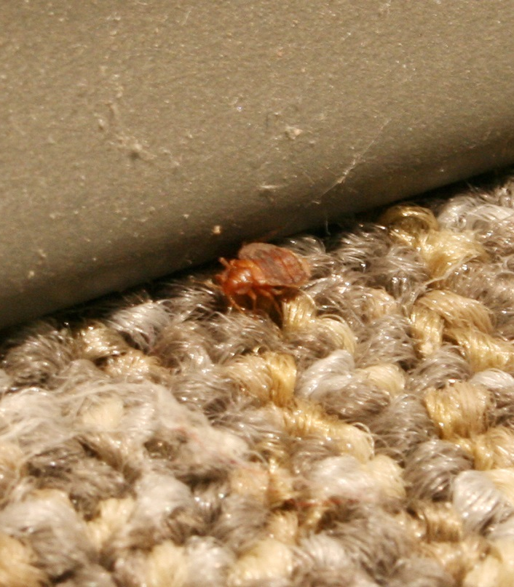

Why have bed bug infestations re-emerged in the developed world?
Reduction in pesticide use indoors
Increase in global travel
Insecticide resistance
Transient homeless
Loss of DDT?
– No way!

Slide 28
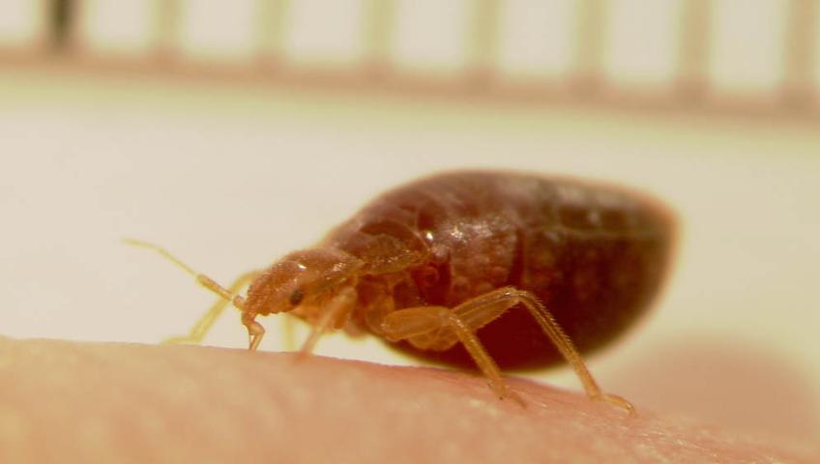

Slide 29
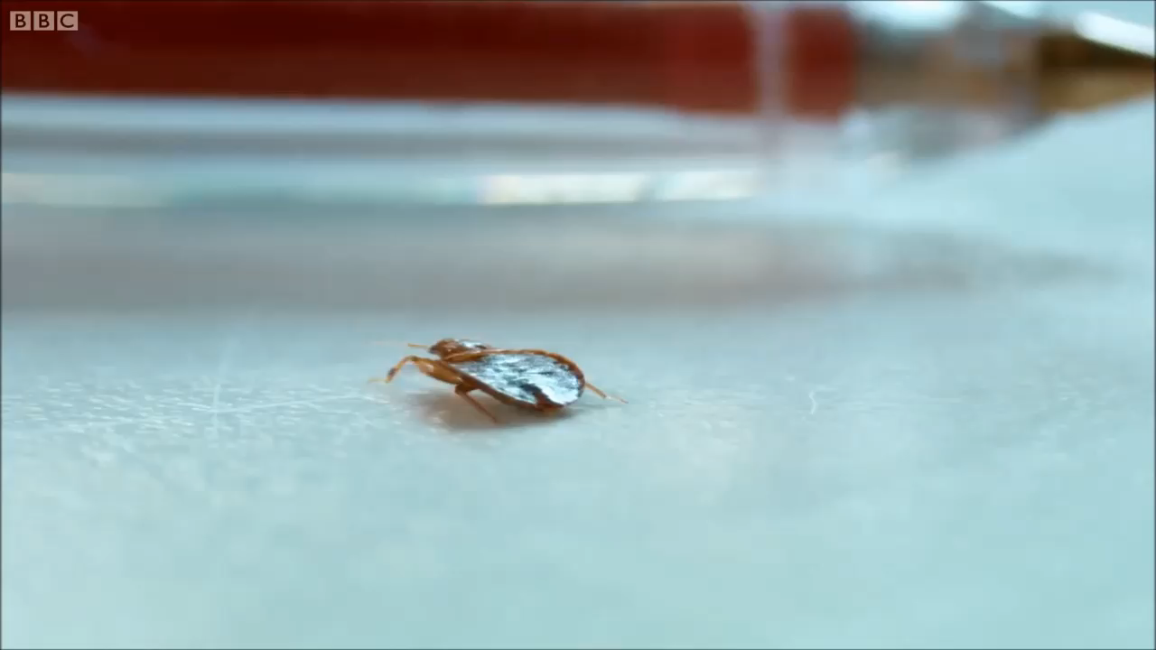

Slide 30
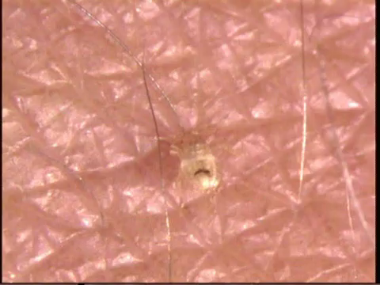

Slide 31
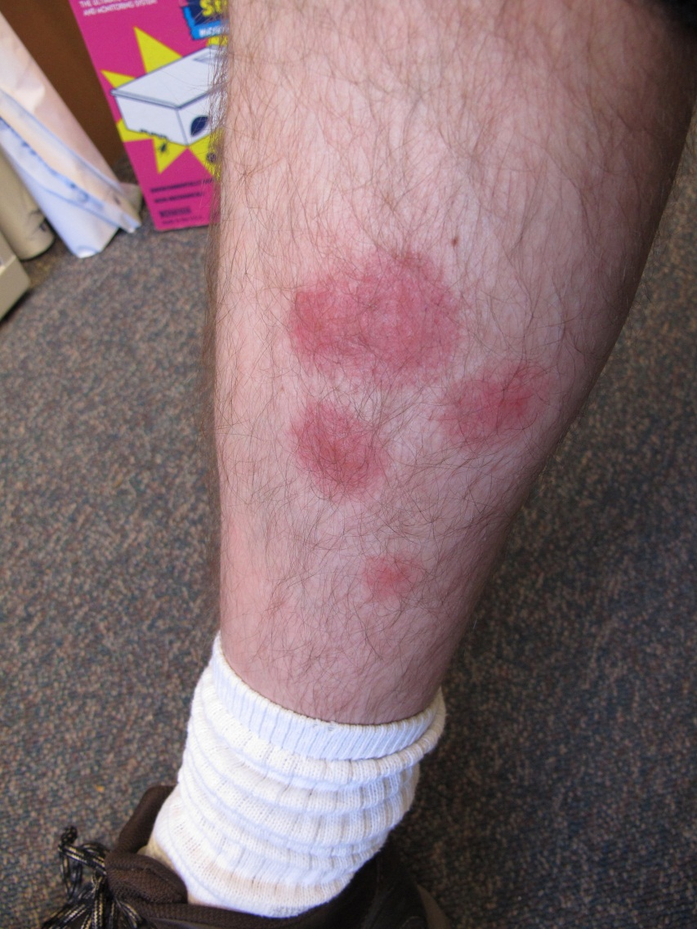
Bed bugs feed on the blood of humans, birds and mice
Saliva can cause a
person to itch
and cause swelling
Scratching can
lead to infected
sores

Slide 32
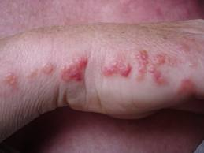
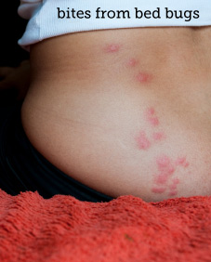
Bites may occur in lines
- usually on exposed skin

Slide 33
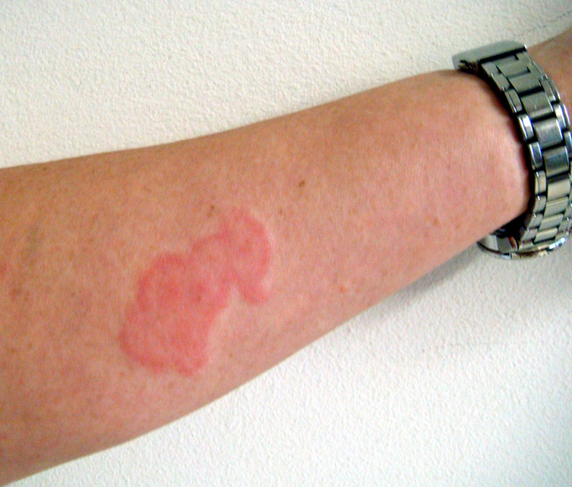
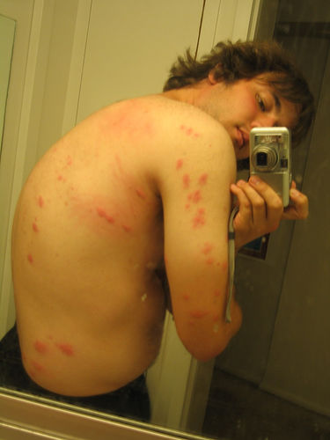
  One study found 30% had a reaction
  Another study indicated 96% had reactions
  Reactions vary depending on your immune system and number of bites
  Bites do not confirm bed bug infestations
*(of refugees in Sierra Leone)

Slide 34
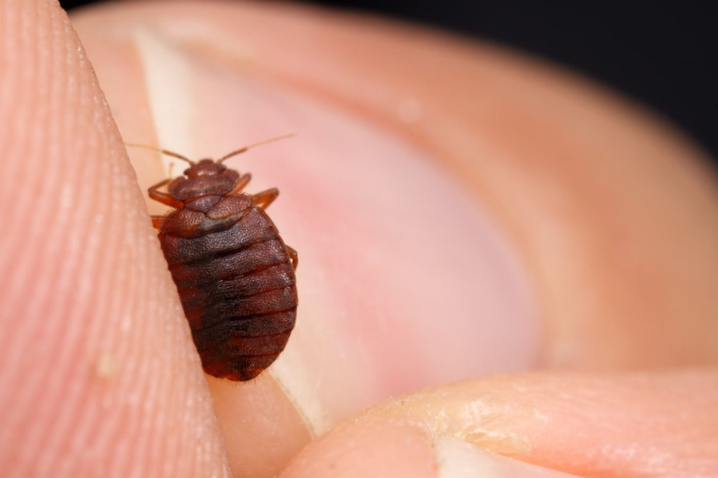
Saliva causes a “sensitivity” to bites
5 stages: no reaction; delayed reaction; both immediate & delayed; immediate reaction only; & finally, no visible reaction.
True hypersensitivity can develop
Asthma
Anemia
Skin lesions
(multiple bites)

Slide 35







A day in the life of a bed bug
Hiding
Feeding

Slide 36


Aggregate in cracks and crevices all day
If hungry they become active between midnight and 5:00 am
Stimulated by the
increase of CO₂ temperature,
other chemicals
Travel many yards
to get to host
Cannot fly or jump!

Slide 37

Probe the skin to find a capillary space that allows the blood to flow rapidly
May probe the skin several times before feeding
Feed for 5-10 min
After feeding, move
to aggregations
Bed bugs usually
feed every 3-7 days

Slide 38

After feeding adults become interested in mating
They engage in
traumatic insemination
Females may be
mated by many
different males
Females leave
aggregations after
being mated several times

Slide 39

Females that mate only once will produce 25% more eggs than multi-mated females
A single mated female can cause an infestation
After taking a blood
meal females
produce 5-20 eggs
over ~12 days
Females produce
~143 eggs in a lifetime

Slide 40


Signs
Excreted
digested blood
Looks like
cockroach
feces but feels
flat or smooth

Slide 41

Frass spots (bed bug poop)
  Mattress seams and on the tag
  Wood frame of the box springs
  Behind the head board
  Along the tops of
  baseboards / the edge
  of carpeting
  Ceiling / wall junctions
  behind pictures
  Electrical outlets
  In curtain seams

Slide 42



Slide 43

Fecal Crust

Slide 44


Blind resident in
disabled public
housing

Slide 45




Slide 46


Slide 47



Slide 48


Slide 49


Slide 50








Combine inspection with vacuum cleaning
Use a brush, flash-light, canister vacuum
with a crevice
attachment

Slide 51


Not all aggregations are obvious

Slide 52



Slide 53


Molted Skins

Slide 54


Less Obvious Unless You Know
Looks like mold
But are actually bed bug aggregations
What are we looking at?

Slide 55



Slide 56



Blood
Smash and
Drag

Slide 57



Slide 58





Slide 59

Most products will kill some bed bugs
Consumers do not realize that killing bed bugs we can see is not the problem
1 exterior
3 partial
16 internal

Slide 60

Social Impacts of bed bugs
2007-2011 data from individuals calling by phone, sending written correspondence, or attending educational /
outreach events

Slide 61

Most commonly used pesticide choices for residents battling bed bugs was total release foggers, & aerosol sprays
9% of residents had
applied gasoline on
their bed (one PHA
training)
19% of people had
attempted
non-chemical control
31% had used more
than two chemicals

Slide 62

42% people understand
what behaviors put
them at risk
89% indicated
extreme stress,
100% indicated
some anxiety
4.5% of residents
attempted to seal
cracks and crevices
8.9% had paid a company
to remediate the infestation

Slide 63

Few (>7%) people had no concerns when informed of average remediation costs
32% of specimens submitted as bed bugs or possible bed bugs were not bed bugs
$400-5000
Fumigation
Heat treatments
Pesticides

Slide 64



The poor are
at greatest risk
Increased number of people reporting long-term (beyond a year) bed bugs

Slide 65

Over the counter pesticides used in/on school backpacks
Children missing school for more than 6 months
Psychiatric patients refused admission to medical facilities
Isolation from friends and family
Bed bug detection dogs providing false positives

Slide 66

Other observations
Doctors and PA’s misdiagnose bed bugs based on bite
reactions

Slide 67


Loss of:
Home and/or belongings
Financial stability
Mental stability
Partner
Employment
Health
Children?

Slide 68


In 2012 we developed an on-line survey tool to methodically determine bed bug impacts and analyze the behavioral risk factors associated with bed bug infestations
2014 launch
Bed Bug survey in English: http://www.surveymonkey.com/s/DGLQS52
Bed Bug survey in Spanish: https://es.surveymonkey.com/s/F5NZXJK

Slide 69


Slide 70


Slide 71

Bed bugs in schools
Schools are NOT effective breeding sites

Slide 72

Bed bugs in schools
Schools can be excellent transfer sites

Slide 73

East Coast School District >3500 confirmed cases in classrooms in 2011,
Department of Education

Slide 74

Chemical disaster zones

Slide 75


Slide 76

Chemical disaster zones

Slide 77

Malathion
Lab results:
Malathion 581.09 ug

Slide 78

Misuse – Sevin Dust
Grandparents used Sevin Dust to treat bed bugs … “it worked for someone else”

Slide 79




Unlabeled Mothballs
Chinese Chalk
Tres Pasitos
Products without a pesticide label are illegal !
Notes:
Examples of illegal pesticides are pictured.
The three pictures on the left are of unlabeled packages of mothballs.
The fourth photo is Chinese Chalk. People illegally use this unregistered pesticide to kill cockroaches. But the “chalk” could seriously harm people, especially children and pets.
The fifth photo is Tres Pasitos—“three little steps” in Spanish. The phrase refers to the number of steps mice take before they die.
Insecticide “chalk” (a.k.a. Miraculous or Chinese Chalk) and Tres Pasitos are two common illegal pesticides sold by street vendors or at ethnic markets.
Pesticides are illegal when they are not registered by the EPA or the state within which they are used or they are used against the label. Illegal pesticides should not be purchased or used.
Illegal pesticides may be stronger than ones that are legal for residential use. People may be tempted to purchase and use illegal pesticides because they are fast-acting. These products are illegal and harmful to people and pets.
In Boston, there has been success with pesticide buy-backs where residents are paid for the pesticides they have in their home.

Slide 80

Do not use foggers and “bombs”
Notes:
80
Refer back to previous discussion.

Slide 81




Slide 82
Number of fatalities US 2009:
Heart disease 779,367
Cancer 568,668
Motor vehicles 36,284
Homicide 16,591
Flu 2,808
Accidental gun 588
WNV 32
Honey bees ~20
Chlorpyrifos &/or pyrophus* >20 cases
Malaria 4
Bed bugs 0
Number of deaths in US in 2009 = 2,436,682
* Applied for bed bug control

Slide 83


Bed bugs everywhere not just homes
Medical
Cinemas
Libraries
Elder/disabled care
Cinemas/theatres
Retail outlets
Transportation
Schools/childcare

Slide 84
Places most likely to have bed bug infestations
Homes and places where people sleep
Offices
Schools
0 of 28

Slide 85
Bed Bugs can disperse by……..
Flying and jumping on to new hosts
Crawling on to clothing, backpacks, shoes and personal items of hosts
Attaching to pets and dropping off when they sense a human host
0 of 28

Slide 86
Bed bugs harm us by…
Biting, feeding on our blood, disturbing sleep
Transmitting deadly blood-borne diseases
Staining beds, bedding, clothes and furniture
Causing adverse social and financial effects
Attacking and infesting our pets
0 of 28

Slide 87
The size of an adult bed bug is ……..
The size of a pin head at first, and the size of a pea after feeding
About the size of a sesame seed
About the size of an apple seed
0 of 28

Slide 88

Disinformation
Modern Woman Digest
Disturbing New Trend:
Kids Are Now Smoking Bed Bugs To Get High
“Just when us adults thought that the children of today couldn’t get any more stupid, they come up with a new and amazing way to get high, rewriting the definition of probably a bad idea.”
This fad originated in Arizona, where a group of kids thought up the bright idea of capturing bed bugs, crushing up the bodies, and inserting the pieces
into “bongs”. The children then light the
bongs and inhale the fumes.
Inhaling the smoke coming off of the bed bug pieces, they experience visual and auditory hallucinations. Bed bugs are known in the scientific community to secrete an active hallucinogenic chemical, that produces a feeling that resembles “walking on wet concrete.”

Slide 89
Managing Bed Bugs….
… to be continued

